Slide 1
More on Conditionals

Slide 2

Objectives
After completing this lesson, you should be able to:
  Correctly use all of the conditional operators
  Test equality between string values
  Chain an if/else statement to achieve the desired result
  Use a switch statement to achieve the desired result
  Debug your Java code by using the NetBeans debugger to step through code line by line and view variable values
Notes:
Java SE 8 Fundamentals 10 - <number>

Slide 3
Topics
  Relational and conditional operators
  More ways to use if/else statements
  Using a switch statement
  Using the NetBeans debugger
Notes:
Java SE 8 Fundamentals 10 - <number>

Slide 4
Review: Relational Operators
Condition | Operator | Example
Is equal to | == | int i=1; (i == 1)
Is not equal to | != | int i=2; (i != 1)
Is less than | < | int i=0; (i < 1)
Is less than or equal to | <= | int i=1; (i <= 1)
Is greater than | > | int i=2; (i > 1)
Is greater than or equal to | >= | int i=1; (i >= 1)
Notes:
By way of review, here you see a list of all the relational operators. Previously, you used the == operator to test equality for numeric values. However, String variables are handled differently because a String variable is an object reference, rather than a primitive value.
Java SE 8 Fundamentals 10 - <number>

Slide 5




Testing Equality Between String variables
Example:
public class Employees {
public String name1 = "Fred Smith";
public String name2 = "Sam Smith";
public void areNamesEqual() {
if (name1.equals(name2)) {
System.out.println("Same name.");
}
else {
System.out.println("Different name.");
}
}
}
Notes:
If you use the == operator to compare object references, the operator tests to see whether both object references are the same (that is, do the String objects point to the same location in memory). For a String it is likely that instead you want to find out whether the characters within the two String objects are the same. The best way to do this is to use the equals method.
Java SE 8 Fundamentals 10 - <number>

Slide 6
Testing Equality Between String variables
Example:
public class Employees {
public String name1 = "Fred Smith";
public String name2 = "fred smith";
public void areNamesEqual() {
if (name1.equalsIgnoreCase(name2)) {
System.out.println("Same name.");
}
else {
System.out.println("Different name.");
}
}
}
Notes:
There is also an equalsIgnoreCase method that ignores the case when it makes the comparison.
Java SE 8 Fundamentals 10 - <number>

Slide 7
Testing Equality Between String variables
Example:
public class Employees {
public String name1 = "Fred Smith";
public String name2 = "Fred Smith";
public void areNamesEqual() {
if (name1 == name2) {
System.out.println("Same name.");
}
else {
System.out.println("Different name.");
}
}
}
Notes:
Depending on how the String variables are initialized, == might actually be effective in comparing the values of two String objects, but only because of the way Java deals with strings.
In this example, only one object was created to contain "Fred Smith" and both references (name1 and name2) point to it. Therefore, name1 == name2 is true. This is done to save memory. However, because String objects are immutable, if you assign name1 to a different value, name2 is still pointing to the original object and the two references are no longer equal.
Java SE 8 Fundamentals 10 - <number>

Slide 8
Testing Equality Between String variables
Example:
public class Employees {
public String name1 = new String("Fred Smith");
public String name2 = new String("Fred Smith");
public void areNamesEqual() {
if (name1 == name2) {
System.out.println("Same name.");
}
else {
System.out.println("Different name.");
}
}
}
Notes:
When you initialize a String using the new keyword, you force Java to create a new object in a new location in memory even if a String object containing the same character values already exists. Therefore in the following example, name1 == name2 would return false.
It makes sense then that the safest way to determine equality of two string values is to use the equals method.
Java SE 8 Fundamentals 10 - <number>

Slide 9
Common Conditional Operators
Operation | Operator | Example
If one condition AND another condition | && | int i = 2; int j = 8; ((i < 1) && (j > 6))
If either one condition OR another condition | || | int i = 2; int j = 8; ((i < 1) || (j > 10))
NOT | ! | int i = 2; (!(i < 3))
Notes:
Relational operators are often used in conjunction with conditional operators. You might need to make a single decision based on more than one condition. Under such circumstances, you can use conditional operators to evaluate complex conditions as a whole.
The table in the slide lists the common conditional operators in the Java programming language. For example, all of the examples in the table yield a boolean result of false.
Discussion: What relational and conditional operators are expressed in the following paragraph?
If the toy is red, I will purchase it. However, if the toy is yellow and costs less than a red item, I will also purchase it. If the toy is yellow and costs the same as or more than another red item, I will not purchase it. Finally, if the toy is green, I will not purchase it.
Java SE 8 Fundamentals 10 - <number>

Slide 10
Ternary Conditional Operator
Operation | Operator | Example
If some condition is true, assign the value of value1 to the result. Otherwise, assign the value of value2 to the result. | ?: | condition ? value1 : value2 Example: int x = 2, y = 5, z = 0; z = (y < x) ? x : y;
Equivalent statements
if(y<x){
z=x;
}
else{
z=y;
}
z = (y < x) ? x : y;
Notes:
The ternary operator is a conditional operator that takes three operands. It has a more compact syntax than an if/else statement.
Use the ternary operator instead of an if/else statement if you want to make your code shorter. The three operands shown in the example above are described here:
(y < x): This is the boolean expression (condition) being evaluated.
? x : If (y < x) is true, z will be assigned the value of x.
: y : If (y < x) is false, z will be assigned the value of y.
Java SE 8 Fundamentals 10 - <number>

Slide 11
Using the Ternary Operator
Advantage: Usable in a single line
int numberOfGoals = 1;
String s = (numberOfGoals==1 ? "goal" : "goals");
System.out.println("I scored " +numberOfGoals +" " +s );
Advantage: Place the operation directly within an expression
int numberOfGoals = 1;
System.out.println("I scored " +numberOfGoals +" " +(numberOfGoals==1 ? "goal" : "goals") );
Disadvantage: Can have only two potential results
(numberOfGoals==1 ? "goal" : "goals" : "More goals");
boolean
true
false
???
Notes:
Based on the number of goals scored, these examples will print the appropriate singular or plural form of “goal.”
The operation is compact because it can only yield two results, based on a boolean expression.
Java SE 8 Fundamentals 10 - <number>

Slide 12

Exercise 10-1: Using the Ternary Operator
In this exercise, you use a ternary operator to duplicate the same logic shown in this if/else statement:
01 int x = 4, y = 9;
02 if ((y / x) < 3){
03 x += y;
04 }
05 else x *= y;
Notes:
In the Java Code Console, access Lessons > 10-MoreConditions > Exercise1
Follow the instructions below the code editor to write a ternary statement that solves the same problem as the if/else statement in this Java class (and shown above).
Print the result.
Run the file to test your code.
Note: If you need help, click the Solution link. To go back to your code, click the Exercise link again. Any changes that you have made will have been saved.
Java SE 8 Fundamentals 10 - <number>

Slide 13
Topics
  Relational and conditional operators
  More ways to use if/else statements
  Using a switch statement
  Using the NetBeans debugger
Notes:
Java SE 8 Fundamentals 10 - <number>

Slide 14

Java Puzzle Ball
Have you played through Basic Puzzle 12?
  Consider the following:
  What happens if the ball strikes the blade?
Notes:
This is the question you were asked to think about before this lesson began. What conclusions did you reach? In this topic, some Java concepts and principles will be discussed that can help explain this behavior.
Java SE 8 Fundamentals 10 - <number>

Slide 15

Java Puzzle Ball Debrief
  What happens if the ball strikes the blade?
    if the ball strikes the blade:
      Transform the ball into a blade
    if the ball is a blade && it strikes the fan:
      The ball is blown in the direction of the fan
    if the ball is a blade && it strikes any object other than the fan || blade:
      Destroy that object
      Transform the ball back into a ball
Notes:
The logic driving the behavior in the game is conditional upon what type of object the ball (or blade) strikes. This lesson introduces some new conditional constructs and some new ways of using the constructs that you already know.
Java SE 8 Fundamentals 10 - <number>

Slide 16
Handling Complex Conditions with a Chained if Construct
The chained if statement:
  Connects multiple conditions together into a single construct
  Often contains nested if statements
  Tends to be confusing to read and hard to maintain
Notes:
Java SE 8 Fundamentals 10 - <number>

Slide 17
Determining the Number of Days in a Month
01 if (month == 1 || month == 3 || month == 5 || month == 7
02 || month == 8 || month == 10 || month == 12) {
03 System.out.println("31 days in the month.");
04 }
05 else if (month == 2) {
06 if(!isLeapYear){
07 System.out.println("28 days in the month.");
08 }else System.out.println("29 days in the month.");
09 }
10 else if (month ==4 || month == 6 || month == 9
11 || month == 11) {
12 System.out.println("30 days in the month.");
13 }
14 else
15 System.out.println("Invalid month.");
Notes:
The code example above shows how you would use a chained and nested if to determine the number of days in a month.
Notice that, if the month is 2, a nested if is used to check whether it is a leap year.
Note: Debugging (covered later in this lesson) would reveal how every if/else statement is examined up until a statement is found to be true.
Java SE 8 Fundamentals 10 - <number>

Slide 18
Chaining if/else Constructs
Syntax:
01 if <condition1> {
02 //code_block1
03 }
04 else if <condition2> {
05 // code_block2
06 }
07 else {
08 // default_code
09 }
Notes:
You can chain if and else constructs together to state multiple outcomes for several different expressions. The syntax for a chained if/else construct is shown in the slide example, where:
Each of the conditions is a boolean expression.
code_block1 represents the lines of code that are executed if condition1 is true.
code_block2 represents the lines of code that are executed if condition1 is false and condition2 is true.
default_code represents the lines of code that are executed if both conditions evaluate to false.
Java SE 8 Fundamentals 10 - <number>

Slide 19
Exercise 10-2: Chaining if Statements
In this exercise, you write a calcDiscount method that determines the discount for three different customer types:
  Nonprofits get a discount of 10% if total > 900, else 8%.
  Private customers get a discount of 7% if total > 900, else no discount.
  Corporations get a discount of 8% if total > 500, else 5%.
Notes:
In the Java Code Console, access Lessons > 10-MoreConditions > Exercise2.
Click the Order tab and follow the instructions below the code editor to code the body of the calcDiscount method as described above.
Click the ShoppingCart tab and click Run to test your code.
Note: If you need help, click the Solution link. To go back to your code, click the Exercise link again. Any changes that you have made will have been saved.
Java SE 8 Fundamentals 10 - <number>

Slide 20
Topics
  Relational and conditional operators
  More ways to use if/else statements
  Using a switch statement
  Using the NetBeans debugger
Notes:
Java SE 8 Fundamentals 10 - <number>

Slide 21
Handling Complex Conditions with a switch Statement
The switch statement:
  Is a streamlined version of chained if statements
  Is easier to read and maintain
  Offers better performance
Notes:
Java SE 8 Fundamentals 10 - <number>

Slide 22
Coding Complex Conditions: switch
01 switch (month) {
02 case 1: case 3: case 5: case 7:
03 case 8: case 10: case 12:
04 System.out.println(“31 days in the month.”);
05 break;
06 case 2:
07 if (!isLeapYear) {
08 System.out.println(“28 days in the month.”);
09 } else
10 System.out.println(“29 days in the month.”);
11 break;
12 case 4: case 6: case 9: case 11:
14 System.out.println("30 days in the month.");
15 break;
default:
System.out.println(“Invalid month.");
18 }
Notes:
Here you see an example of the same conditional logic (from the previous chained if example) implemented as a switch statement. It is easier to read and understand what is happening here.
The month variable is evaluated only once, and then matched to several possible values.
Notice the break statement. This causes the switch statement to exit without evaluating the remaining cases.
Note: Debugging (covered later in this lesson) reveals why the switch statement offers better performance compared to an if/else construct. Only the line containing the true case is executed in a switch construct, whereas every if/else statement must be examined up until a statement is found to be true.
Java SE 8 Fundamentals 10 - <number>

Slide 23
switch Statement Syntax
Syntax:
01 switch (<variable or expression>) {
02 case <literal value>:
03 //code_block1
04 [break;]
05 case <literal value>:
06 // code_block2
07 [break;]
08 default:
09 //default_code
{
Notes:
The switch construct helps you avoid confusing code because it simplifies the organization of the various branches of code that can be executed.
The syntax for the switch construct is shown in the slide, where:
The switch keyword indicates a switch statement
variable is the variable whose value you want to test. Alternatively, you could use an expression. The variable (or the result of the expression) can be only of type char, byte, short, int, or String.
The case keyword indicates a value that you are testing. A combination of the case keyword and a literal value is referred to as a case label.
literal value is any valid value that a variable might contain. You can have a case label for each value that you want to test. Literal values can be constants (final variables such as CORP, PRIVATE, or NONPROFIT used in the previous exercise), literals (such as 'A' or 10), or both.
The break statement is an optional keyword that causes the code execution to immediately exit the switch statement. Without a break statement, all code block statements following the accepted case statement are executed (until a break statement or the end of the switch construct is reached).
Java SE 8 Fundamentals 10 - <number>

Slide 24
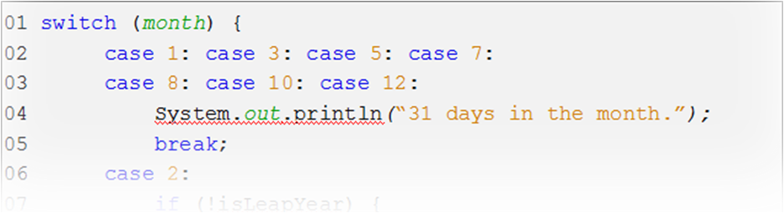
When to Use switch Constructs
Use when you are testing:
  Equality (not a range)
  A single value
  Against fixed known values at compile time
  The following data types:
    Primitive data types: int, short, byte, char
    String or enum (enumerated types)
    Wrapper classes (special classes that wrap certain primitive types):
    Integer, Short, Byte and Character
Only a single (value can be tested.
Known values
Notes:
If you are not able to find values for individual test cases, it would be better to use an if/else construct instead.
Java SE 8 Fundamentals 10 - <number>

Slide 25
Exercise 10-3: Using switch Construct
In this exercise, you modify the calcDiscount method to use a switch construct, instead of a chained if construct:
  Use a ternary operator instead of a nested if within each case block.
Notes:
In the Java Code Console, access Lessons > 10-MoreConditions > Exercise3.
Follow the instructions below the code editor to change the calcDiscount method of the Order class to use a switch construct instead of the chained if construct. You may wish to just comment out the chained if statement so that you will be able to reference it in order to duplicate the logic.
Use a ternary statement in each switch block to replace the nested if statement logic.
Test it by running the ShoppingCart class.
Note: If you need help, click the Solution link. To go back to your code, click the Exercise link again. Any changes that you have made will have been saved.
Java SE 8 Fundamentals 10 - <number>

Slide 26
Quiz
Which of the following sentences describe a valid case to test in a switch construct?
  The switch construct tests whether values are greater than or less than a single value.
  Variable or expression where the expression returns a supported switch type.
  The switch construct can test the value of a float, double, boolean, or String.
  The switch construct tests the outcome of a boolean expression.
Notes:
Answer: b
Answer a is incorrect because you must test for a single value, not a range of values. Relational operators are not allowed.
Answer b is correct.
Answer c is incorrect. The switch construct tests the value of types char, byte, short, int, or String.
Answer d is incorrect. The switch construct tests of value of expressions that return char, byte, short, int, or String—not boolean.
Java SE 8 Fundamentals 10 - <number>

Slide 27
Topics
  Relational and conditional operators
  More ways to use if/else statements
  Using a switch statement
  Using the NetBeans debugger
Notes:
Java SE 8 Fundamentals 10 - <number>

Slide 28

Working with an IDE Debugger
Most IDEs provide a debugger. They are helpful to solve:
  Logic problems
    (Why am I not getting the result I expect?)
  Runtime errors
    (Why is there a NullPointerException?)
Notes:
Debugging can be a useful alternative to print statements.
Java SE 8 Fundamentals 10 - <number>

Slide 29
Debugger Basics
  Breakpoints:
    Are stopping points that you set on a line of code
    Stop execution at that line so you can view the state of the application
  Stepping through code:
    After stopping at a break point, you can “walk” through your code, line by line to see how things change.
  Variables:
    You can view or change the value of a variable at run time.
  Output:
    You can view the System output at any time.
Notes:
Java SE 8 Fundamentals 10 - <number>

Slide 30
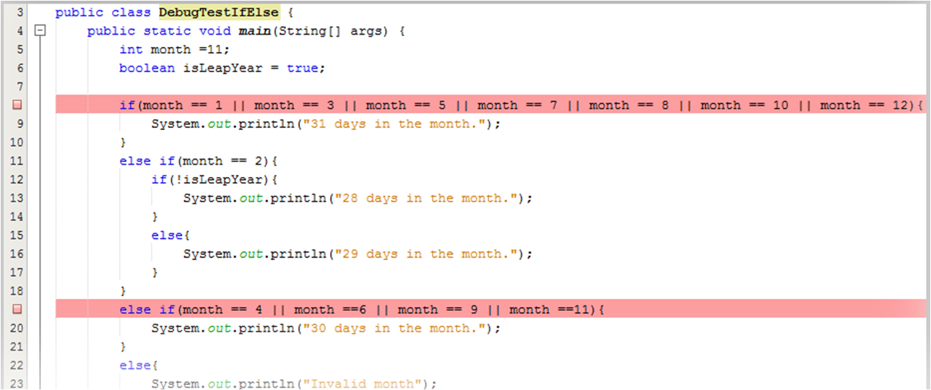
Setting Breakpoints
  To set breakpoints, click in the margin of a line of code.
  You can set multiple breakpoints in multiple classes.
Notes:
Java SE 8 Fundamentals 10 - <number>

Slide 31

The Debug Toolbar
  1. Start debugger
  2. Stop debug session
  3. Pause debug session
  4. Continue running
  5. Step over
  6. Step over an expression
  7. Step into
  8. Step out of
1
2
3
4
5
6
7
8
Notes:
Here you see the Debug toolbar in NetBeans. Each button is numbered and the corresponding description of the function of that button appears in the list on the left.
1. Start the debug session for the current project by clicking button 1. After a session has begun, the other buttons become enabled. The project runs, stopping at the first breakpoint.
2. You can exit the debug session by clicking button 2.
3. Button 3 allows you to pause the session.
4. Button 4 continues running until the next breakpoint or the end of the program.
5. Buttons 5 through 8 give you control over how far you want to drill down into the code. For example:
If execution has stopped just before a method invocation, you may want to skip to the next line after the method.
If execution has stopped just before an expression, you may want to skip over just the expression to see the final result.
You may prefer to step into an expression or method so that you can see how it functions at run time. You can also use this button to step into another class that is being instantiated.
If you have stepped into a method or another class, use the last button to step back out into the original code block.
Java SE 8 Fundamentals 10 - <number>

Slide 32
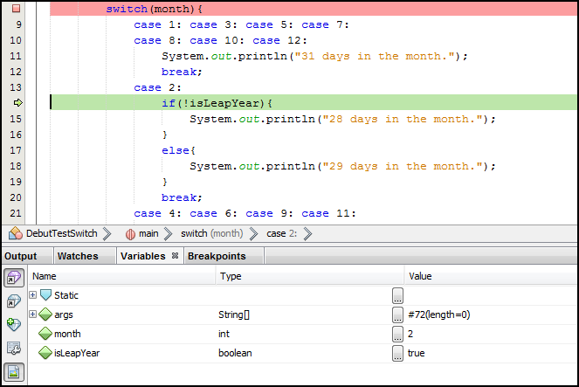
Viewing Variables
Breakpoint
Current line of execution
Value of variables
Notes:
Here you see a debug session in progress. The debugger stopped at the breakpoint line, but then the programmer began stepping through the code. The current line of execution is indicated by the green arrow in the margin.
Notice that the isLeapYear variable on the current line appears in the Variables tab at the bottom of the window. Here you can view the value or even change it to see how the program would react.
Note: Debugging reveals why the switch statement offers better performance compared to an if/else construct. Only the line containing the true case is executed in a switch construct, whereas every if/else statement must be examined up until a statement is found to be true.
Java SE 8 Fundamentals 10 - <number>

Slide 33

Summary
In this lesson, you should have learned how to:
  Use a ternary statement
  Test equality between strings
  Chain an if/else statement
  Use a switch statement
  Use the NetBeans debugger
Notes:
Java SE 8 Fundamentals 10 - <number>

Slide 34
Challenge Question: Java Puzzle Ball
What type of conditional construct would you use to handle the behavior of the blade?
Notes:
When you have an opportunity to play the game, see whether you can “pseudocode” the logic needed to control the behavior of the ball when it has been turned into a blade. You are now familiar with several conditional constructs. Choose the one that you think works best and is easiest to read.
For some possible answers to these questions and more discussion, see “Appendix A: Java Puzzle Ball Challenge Questions Answered.”
Java SE 8 Fundamentals 10 - <number>

Slide 35

Practice 10-1 Overview:
Using Conditional Statements
This practice covers enhancing the getDescription method of the Game class to announce the name of the winning team.
Notes:
Java SE 8 Fundamentals 10 - <number>

Slide 36
Practice 10-2 Overview:
Debugging
This practice covers the following topics:
  Enhancing the showBestTeam method to differentiate between teams with the same number of points
  Using the NetBeans debugger to step through the code line by line
Notes:
Java SE 8 Fundamentals 10 - <number>

